Slide 1
ATAI
Advanced Technique of Artificial Intelligence
ATAI
ChongqingUniversity _{AdvancedTechniqueof}
of Technology Artificial Intelligence
Chongqing University of
Technology
Chongqing University ^{ATAI}
_{of Technology} Advanced Techniqueof
Artificial Intelligence
Chongqing University of Technology
Chongqing University of Technology
OrCo: Towards Better Generalization via Orthogonality and Contrast for Few-Shot Class-Incremental Learning
https://github. com/noorahmedds/OrCo
——CVPR_2024
Reported by Jingbo Liu
1

Slide 2
ATAI
Advanced Technique of Artificial Intelligence
ATAI
ChongqingUniversity _{AdvancedTechniqueof}
of Technology Artificial Intelligence
Chongqing University of
Technology
Chongqing University ^{ATAI}
_{of Technology} Advanced Techniqueof
Artificial Intelligence
Chongqing University of Technology
Chongqing University of Technology
Motive
1) FSCIL methods inherently face the challenge of catastrophic forgetting as data arrives incrementally, making models susceptible to overwriting previously acquired knowledge.
2) Moreover, given the scarcity of labeled samples available at any given time, models may be prone to overfitting and find it challenging to strike a balance between extensive pretraining and the limited incremental data.

Slide 3
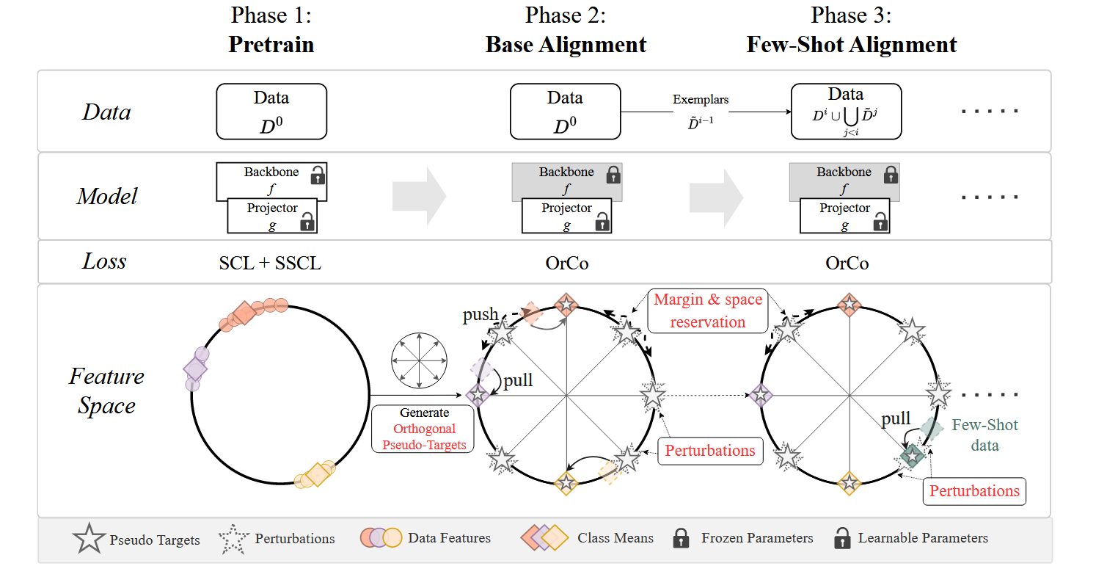
ATAI
ChongqingUniversity _{AdvancedTechniqueof}
of Technology Artificial Intelligence
Chongqing University of
Technology
ATAI
Advanced Technique of Artificial Intelligence
Chongqing University ^{ATAI}
_{of Technology} Advanced Techniqueof
Artificial Intelligence
Chongqing University of Technology
Chongqing University of Technology
Method

Slide 4
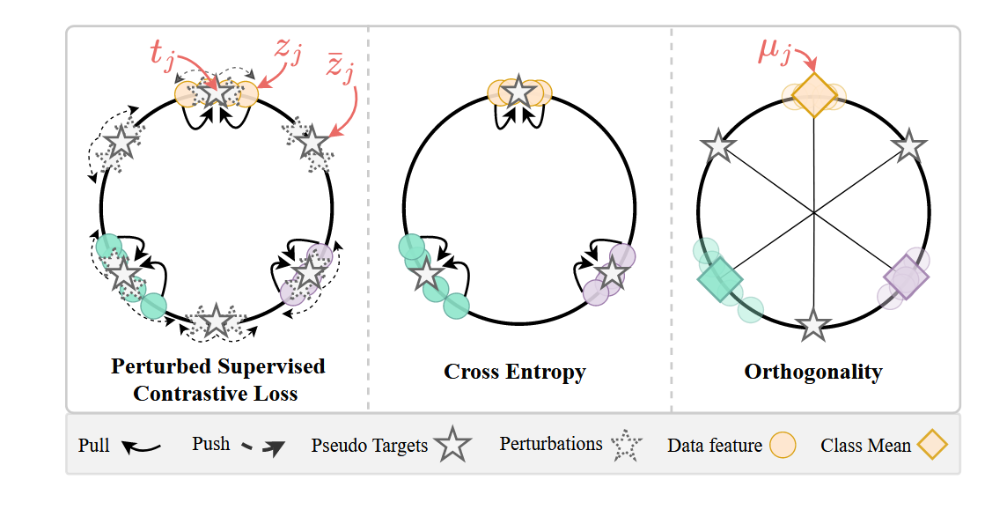
ATAI
ChongqingUniversity _{AdvancedTechniqueof}
of Technology Artificial Intelligence
Chongqing University of
Technology
ATAI
Advanced Technique of Artificial Intelligence
Chongqing University ^{ATAI}
_{of Technology} Advanced Techniqueof
Artificial Intelligence
Chongqing University of Technology
Chongqing University of Technology
Method

Slide 5
ATAI
Advanced Technique of Artificial Intelligence
ATAI
ChongqingUniversity _{AdvancedTechniqueof}
of Technology Artificial Intelligence
Chongqing University of
Technology
Chongqing University ^{ATAI}
_{of Technology} Advanced Techniqueof
Artificial Intelligence
Chongqing University of Technology
Chongqing University of Technology
Method

Slide 6
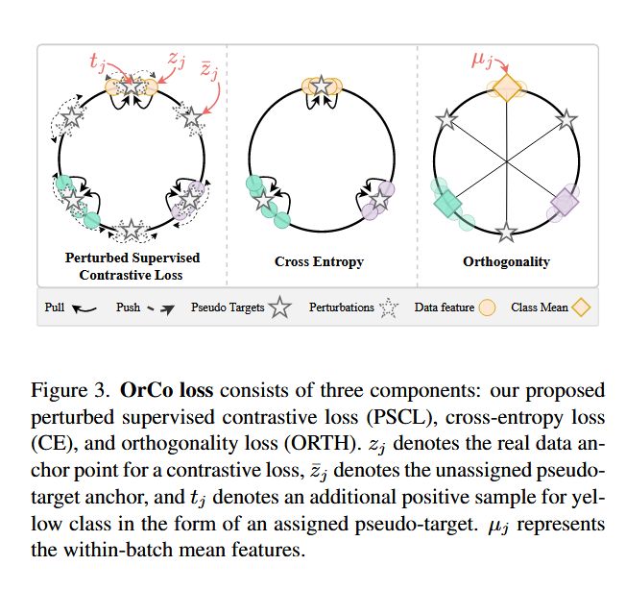
ATAI
Advanced Technique of Artificial Intelligence
ATAI
ChongqingUniversity _{AdvancedTechniqueof}
of Technology Artificial Intelligence
Chongqing University of
Technology
Chongqing University ^{ATAI}
_{of Technology} Advanced Techniqueof
Artificial Intelligence
Chongqing University of Technology
Chongqing University of Technology
Method

Slide 7
ATAI
Advanced Technique of Artificial Intelligence
ATAI
ChongqingUniversity _{AdvancedTechniqueof}
of Technology Artificial Intelligence
Chongqing University of
Technology
Chongqing University ^{ATAI}
_{of Technology} Advanced Techniqueof
Artificial Intelligence
Chongqing University of Technology
Chongqing University of Technology
Method

Slide 8
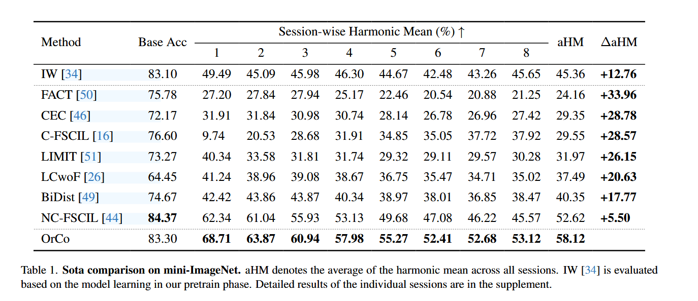
ATAI
Advanced Technique of Artificial Intelligence
ATAI
ChongqingUniversity _{AdvancedTechniqueof}
of Technology Artificial Intelligence
Chongqing University of
Technology
Chongqing University ^{ATAI}
_{of Technology} Advanced Techniqueof
Artificial Intelligence
Chongqing University of Technology
Chongqing University of Technology
Experiments

Slide 9
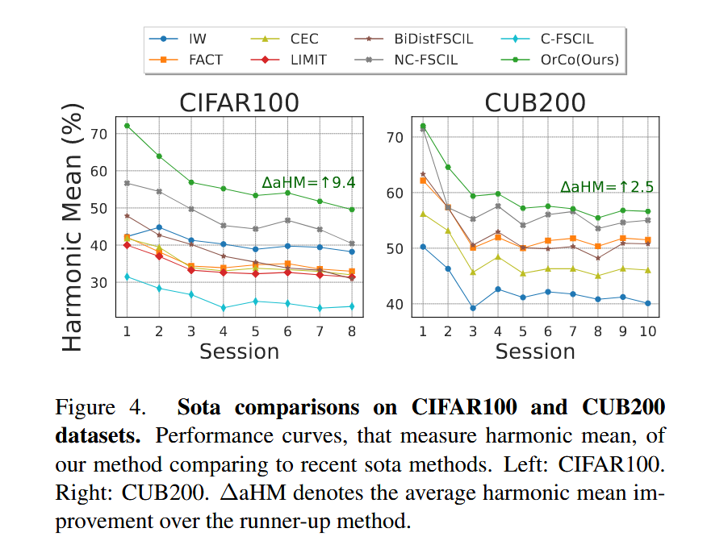
ATAI
Advanced Technique of Artificial Intelligence
ATAI
ChongqingUniversity _{AdvancedTechniqueof}
of Technology Artificial Intelligence
Chongqing University of
Technology
Chongqing University ^{ATAI}
_{of Technology} Advanced Techniqueof
Artificial Intelligence
Chongqing University of Technology
Chongqing University of Technology

Slide 10
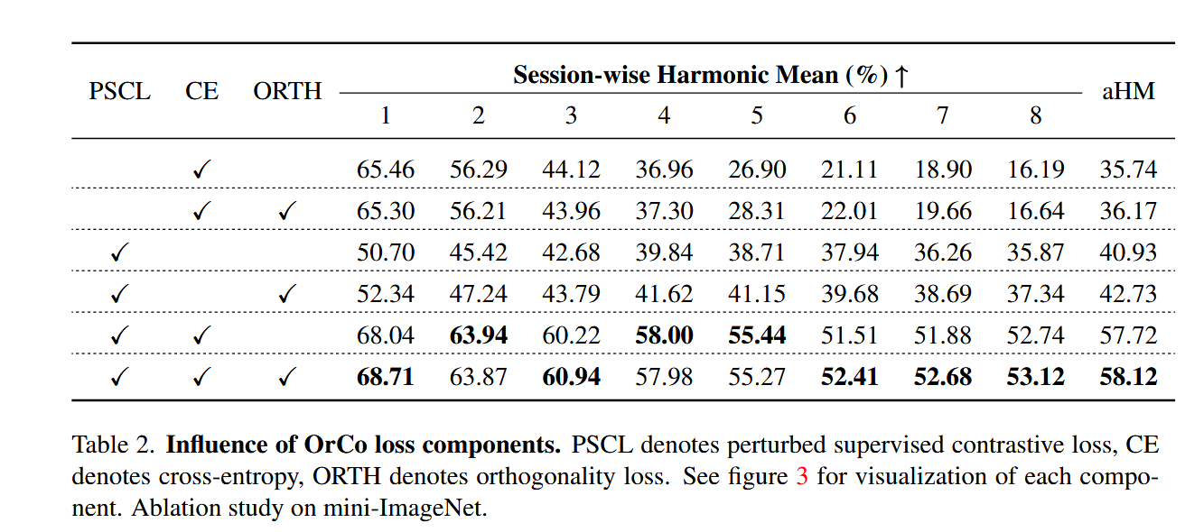
ATAI
Advanced Technique of Artificial Intelligence
ATAI
ChongqingUniversity _{AdvancedTechniqueof}
of Technology Artificial Intelligence
Chongqing University of
Technology
Chongqing University ^{ATAI}
_{of Technology} Advanced Techniqueof
Artificial Intelligence
Chongqing University of Technology
Chongqing University of Technology
Experiments

Slide 11
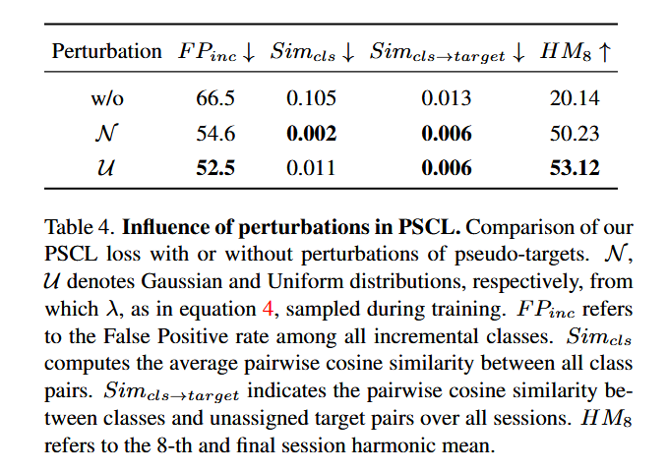
ATAI
Advanced Technique of Artificial Intelligence
ATAI
ChongqingUniversity _{AdvancedTechniqueof}
of Technology Artificial Intelligence
Chongqing University of
Technology
Chongqing University ^{ATAI}
_{of Technology} Advanced Techniqueof
Artificial Intelligence
Chongqing University of Technology
Chongqing University of Technology
Experiments

Slide 12
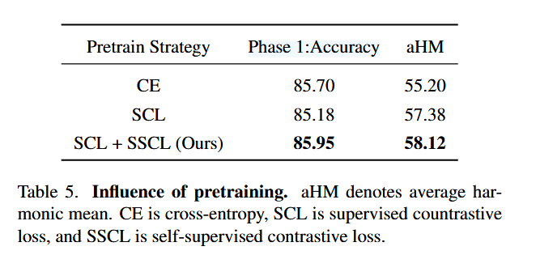
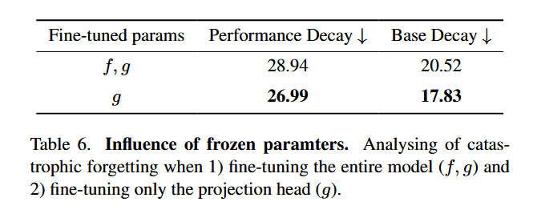
ATAI
Advanced Technique of Artificial Intelligence
ATAI
ChongqingUniversity _{AdvancedTechniqueof}
of Technology Artificial Intelligence
Chongqing University of
Technology
Chongqing University ^{ATAI}
_{of Technology} Advanced Techniqueof
Artificial Intelligence
Chongqing University of Technology
Chongqing University of Technology
Experiments

Slide 13
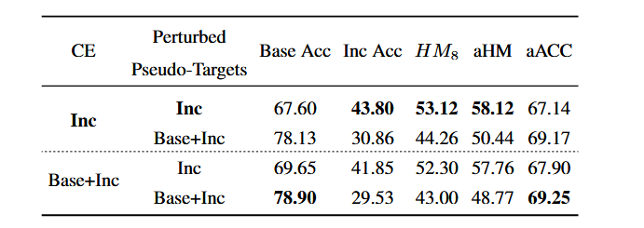
ATAI
Advanced Technique of Artificial Intelligence
ATAI
ChongqingUniversity _{AdvancedTechniqueof}
of Technology Artificial Intelligence
Chongqing University of
Technology
Chongqing University ^{ATAI}
_{of Technology} Advanced Techniqueof
Artificial Intelligence
Chongqing University of Technology
Chongqing University of Technology
Experiments

Slide 14
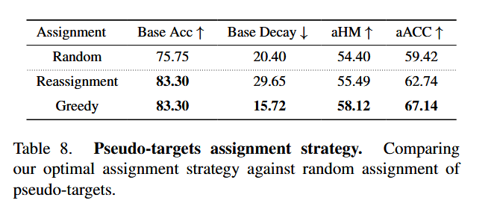
ATAI
Advanced Technique of Artificial Intelligence
ATAI
ChongqingUniversity _{AdvancedTechniqueof}
of Technology Artificial Intelligence
Chongqing University of
Technology
Chongqing University ^{ATAI}
_{of Technology} Advanced Techniqueof
Artificial Intelligence
Chongqing University of Technology
Chongqing University of Technology
Experiments

Slide 15
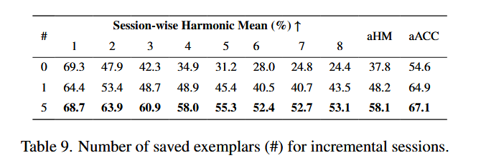
ATAI
Advanced Technique of Artificial Intelligence
ATAI
ChongqingUniversity _{AdvancedTechniqueof}
of Technology Artificial Intelligence
Chongqing University of
Technology
Chongqing University ^{ATAI}
_{of Technology} Advanced Techniqueof
Artificial Intelligence
Chongqing University of Technology
Chongqing University of Technology
Experiments

Slide 16
ATAI
Advanced Technique of Artificial Intelligence
ATAI
ChongqingUniversity _{AdvancedTechniqueof}
of Technology Artificial Intelligence
Chongqing University of
Technology
Chongqing University ^{ATAI}
_{of Technology} Advanced Techniqueof
Artificial Intelligence
Chongqing University of Technology
Chongqing University of Technology
Thanks!

